Slide 1
Machine learning misclassification error detection to enhance safety of Level 3 autonomous driving

Slide 2
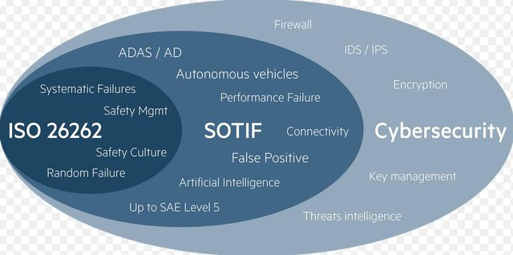
Safety Standards for Automated Vehicles - SOTIF (ISO 21448) and AI
The National Highway Traffic Safety Administration (NHTSA) is prepared to assist with challenges regarding the safe integration of SAE Level 3 and above Automated Driving Systems (ADSs) on public roads.
NHTSA plans to bring ADSs safety onto the Nation’s roadways.
https://www.nhtsa.gov/technology-innovation/automated-vehicles-safety
SOTIF (ISO/PAS 21448) was developed to address the new safety challenges that autonomous (and semi-autonomous) vehicle software developers are facing. This is especially important as artificial intelligence (AI) and machine learning play key roles in the development of autonomous vehicles.
https://www.perforce.com/blog/qac/sotif-iso-pas-21448-autonomous-driving

Slide 3
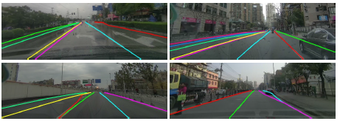
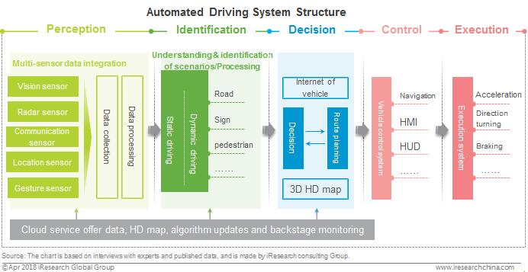
SOTIF-related Hazardous Factors in Machine Learning
Dense Lines:
Fork Lines:
Misjudgments because of the scenes of lane lines with complex topologies:
In-distribution: dense lines, fork lines, road constructions
Out-of-distribution: lane restrictions resulting from unexpected lane changes and sudden car accidents.
San
Jose
Tesla FSD misjudged the vehicle lane and bike lane .
San Francisco
San Francisco
Tesla FSD did not identify the biker.
It begins veering dangerously towards a cyclist riding along the road.
Downtown Detroit
Tesla FSD chose “go straight”, not follow the detour.
Road close sign plus detour may be out of ML learning domain .

Slide 4

Run-time motoring error detector
Pilot systems
(ML models)
Steering
out
Road
Situations (Sensor data)
Predicted
error
(warning)
Take control
back
Error detector
feedback
loop
The error detector (student model) monitors the pre-trained main ML components (teacher model) in parallel.
The error detector predicts teachers’ failures, trigger appropriate warnings, and informs drivers to take back control in a timely manner.
The driver’s responses to the warnings are feedbacked to the error detector for dynamically tuning the parameters of the offline-trained error detector.

Slide 5
Tasks in the project to develop an error detector
Develop a CARLA simulation platform to generate an in-distribution input dataset.
Develop an adversarial generator for OOD examples. This task solves the issue that OOD training examples are usually insufficient since a priori knowledge of OOD is unavailable or its underlying support is too large to cover.
Design the error detector model. The detector is structured in parallel with the monitored ML components and predicts their misclassifications for both in-distribution and OOD examples. This task will release two algorithms – offline and online – to train the baseline model of the error detector and tune the model parameters dynamically.
Interpret the misclassifications using counterfactual explanation techniques. This task attempts to explain why the main ML components make the prediction errors in a certain situation. Interpreting misclassification reasons helps improve the reliability and safety of the ML components.

Slide 6
Offline Training Error Detector (Task III)
In-Distribution Input Dataset (CARLA)
Error Detector
Correctly classified
Saliency
maps
In-distribution test examples for teacher
ML model
(student)
Incorrectly classified
Main ML
Model
(teacher)
Generated
OOD examples
A CARLA simulation platform is developed to generate the in-distribution input dataset
Input examples are labelled into the two classes: “correctly classified” and “incorrectly classified”.
Generated OOD examples are merged into the class of “incorrectly classified”.
A saliency map is created for each example.
Created saliency maps are utilized to train the error detector.
The error detector is verified and validated in the CARLA simulation platform.

Slide 7
Online Training Error Detector (Task III)
Pilot systems
(ML models)
Steering
out
Road
Situations (Sensor data)
Predicted
error
(warning)
Take control
back
Online
reinforcement
learning
Error detector
feedback
loop
The driver’s responses to the warnings are feedbacked to the error detector.
The responses are regarded as rewards (penalties) in reinforcement learning.
The parameters of the offline-trained model are adjusted.
The error detector is not only constantly adjusted to grow even more accurately but also customized to respect the human driver’s individual driving behavior.

Slide 8
OOD Example Generator (Task II)
In-Distribution
Out-of-Distribution
Sample Out-of-Distribution close to In-Distribution (Boundary)
OOD examples are generated close to the boundary of in-distribution examples
The loss function of the GAN is modified to require a small Kullback-Leibler divergence between the uniform distribution and the predictive distribution of OOD provided by the generator.

Slide 9
Error Interpreter (Task IV)
Class A
Class B
Misclassified example
Analyze the track on which a misclassified example is moved back to the ground-truth class.
The error interpreter is developed using counterfactual explanation techniques.
Counterfactual explanation explains predictions of individual instances by analyzing how the feature values cause the prediction.
The key idea is to move a misclassified example in some way to the ground-truth class.
The moving track reflects the smallest change to the feature values that changes the prediction to the correct output.

